Slide 1
ECMC Project Machine Learning Approach for Risk-Based Inspection Screening assessment
Naif Alshehab
01/23/2023
Andika Rachman, R.M. Chandima Ratnayake, Machine learning approach for risk-based inspection screening assessment, Reliability Engineering & System Safety, Volume 185, 2019, Pages 518-532, ISSN 0951-8320, https://doi.org/10.1016/j.ress.2019.02.008.

Slide 2
Introduction

Slide 3
Introduction
Inspecting all equipment is not cost-effective
Risk Based Inspection (RBI) is more optimal.
Focus on inspecting ”High-Risk” Equipment
Screening equipment depends highly on engineering judgment
This makes it vulnerable to human Biases and Errors
In this paper: Machine Learning was utilized to increase subjectivity
Dataset: 3 onshore & 4 offshore gas and oil production and processing units.

Slide 4
Methodology

Slide 5
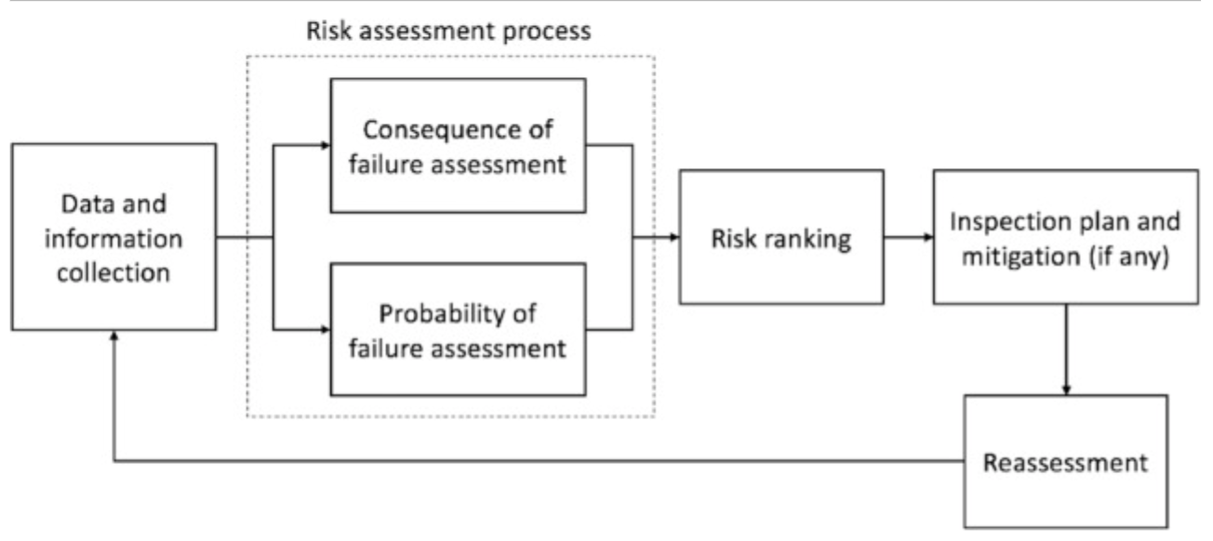
Risk Based Inspection (RBI)
(HE, G., & HADJICONSTANTINOU, N., 2003)

Slide 6
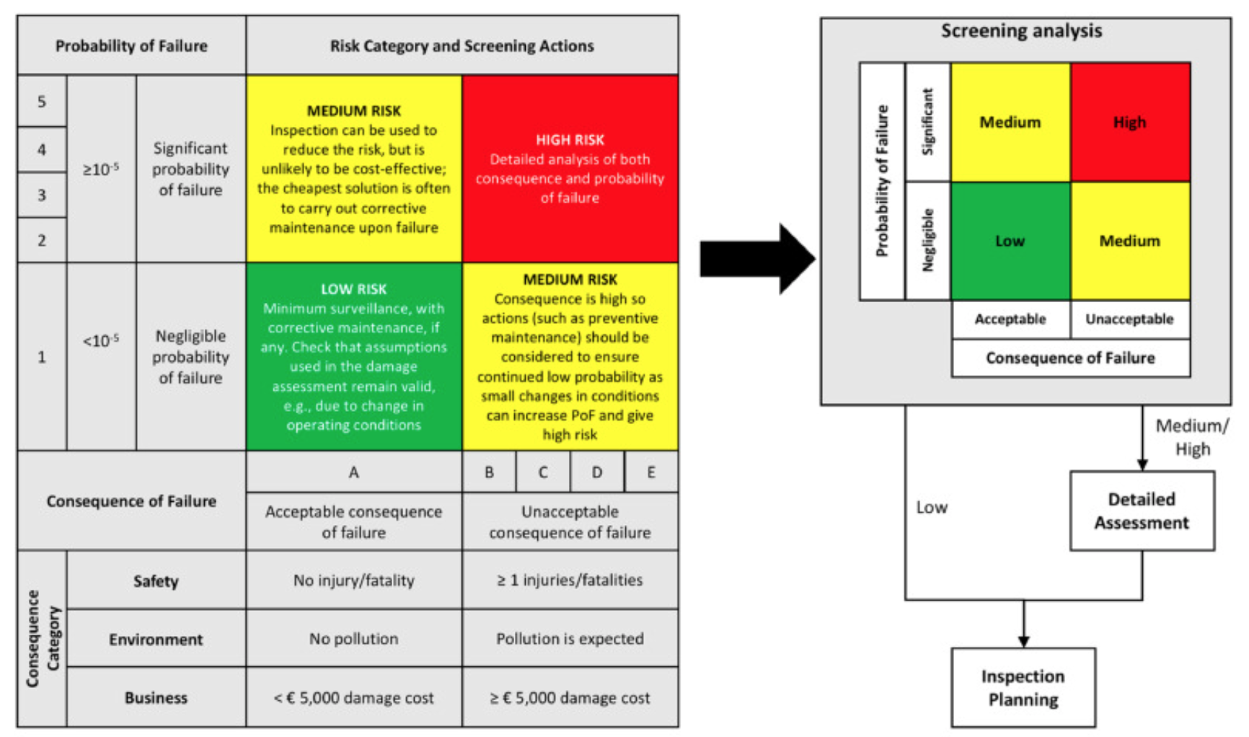
Risk Matrix

Slide 7


Dataset
RBI Detailed Assessment
Onshore
3
Pressure Vessels
200
Instance
1,581
Offshore
4
Pipelines
3,000

Slide 8
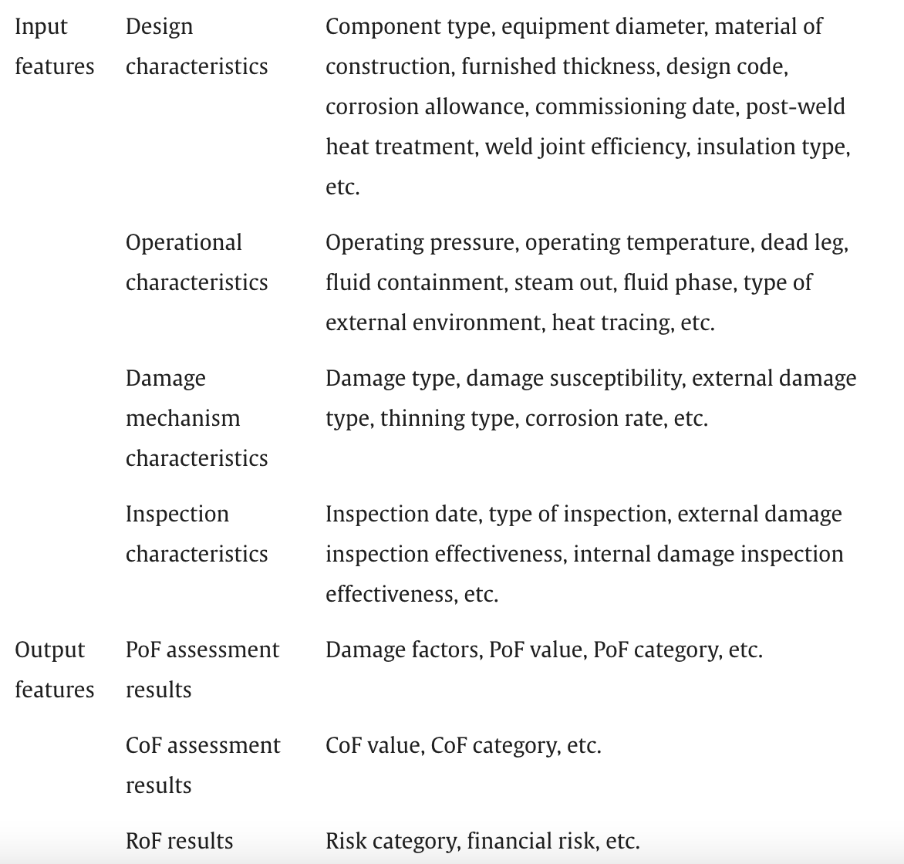
Dataset Features
& Outputs

Slide 9
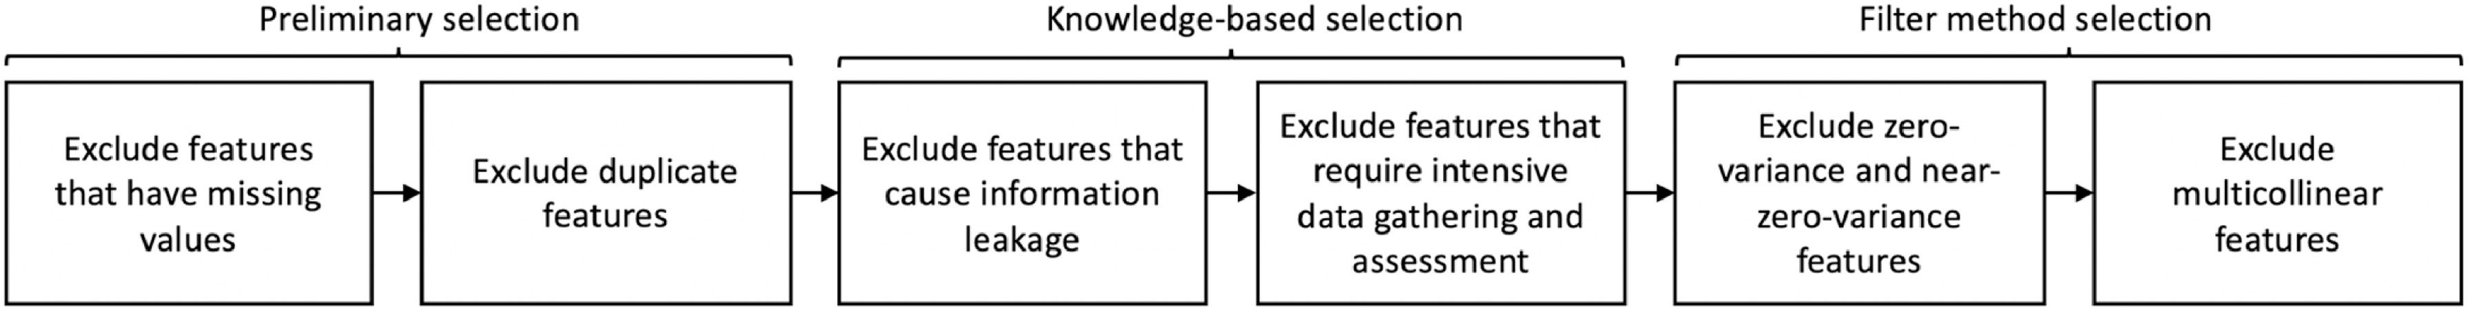
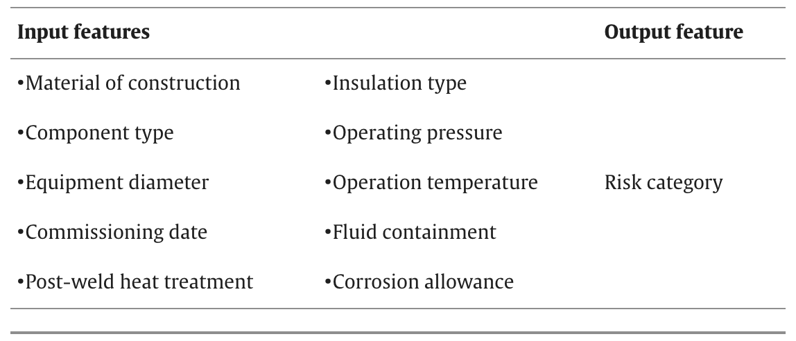
Features Selection

Slide 10
Data Pre-Processing
1
3
Data Cleaning
Data Reduction
2
4
Data Transformation
Data Integration

Slide 11
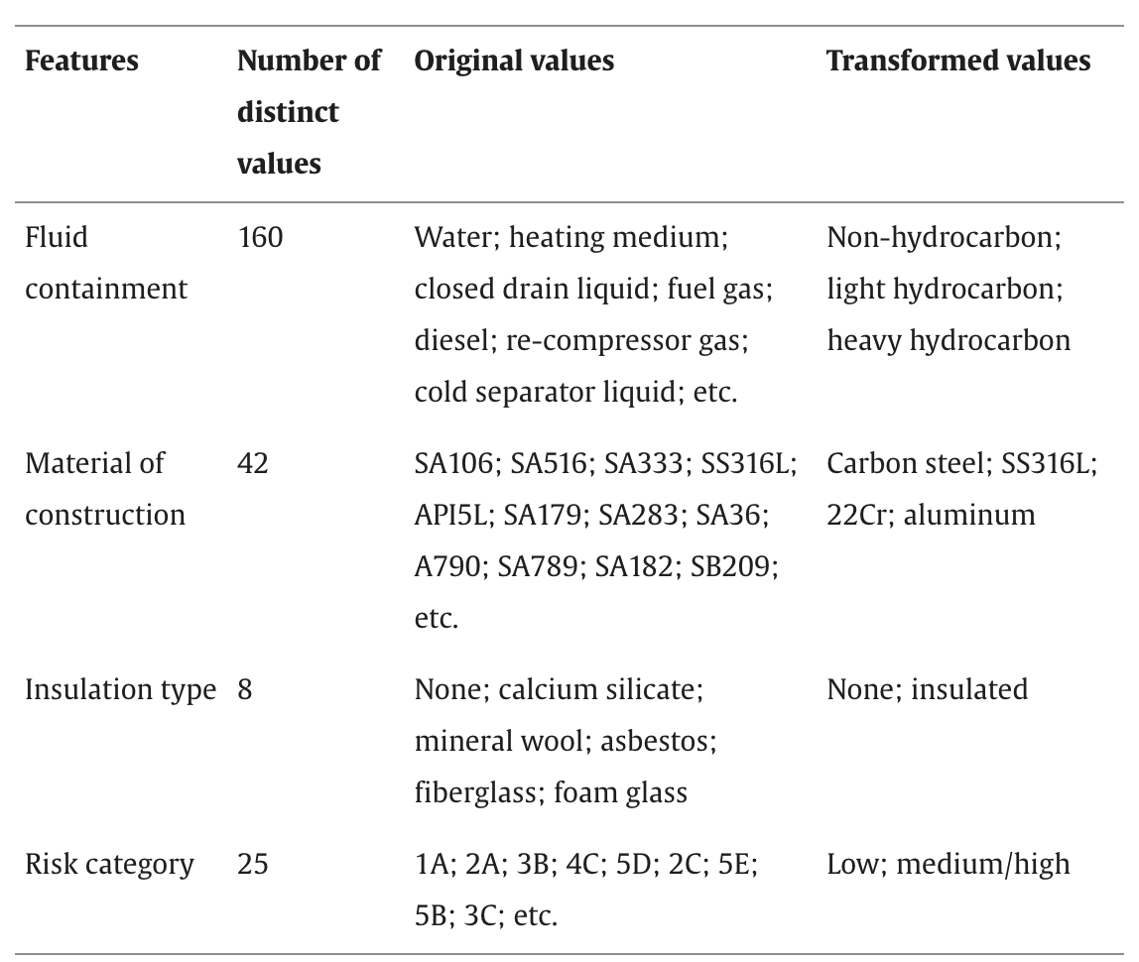
Features Generalization

Slide 12
Machine Learning Models
Logistic Regression
Support Vector Machine (SVM)
K Nearest Neighbors (K-NN)
Gradient Boosting Decision Trees
AdaBoost
Random Forests

Slide 13
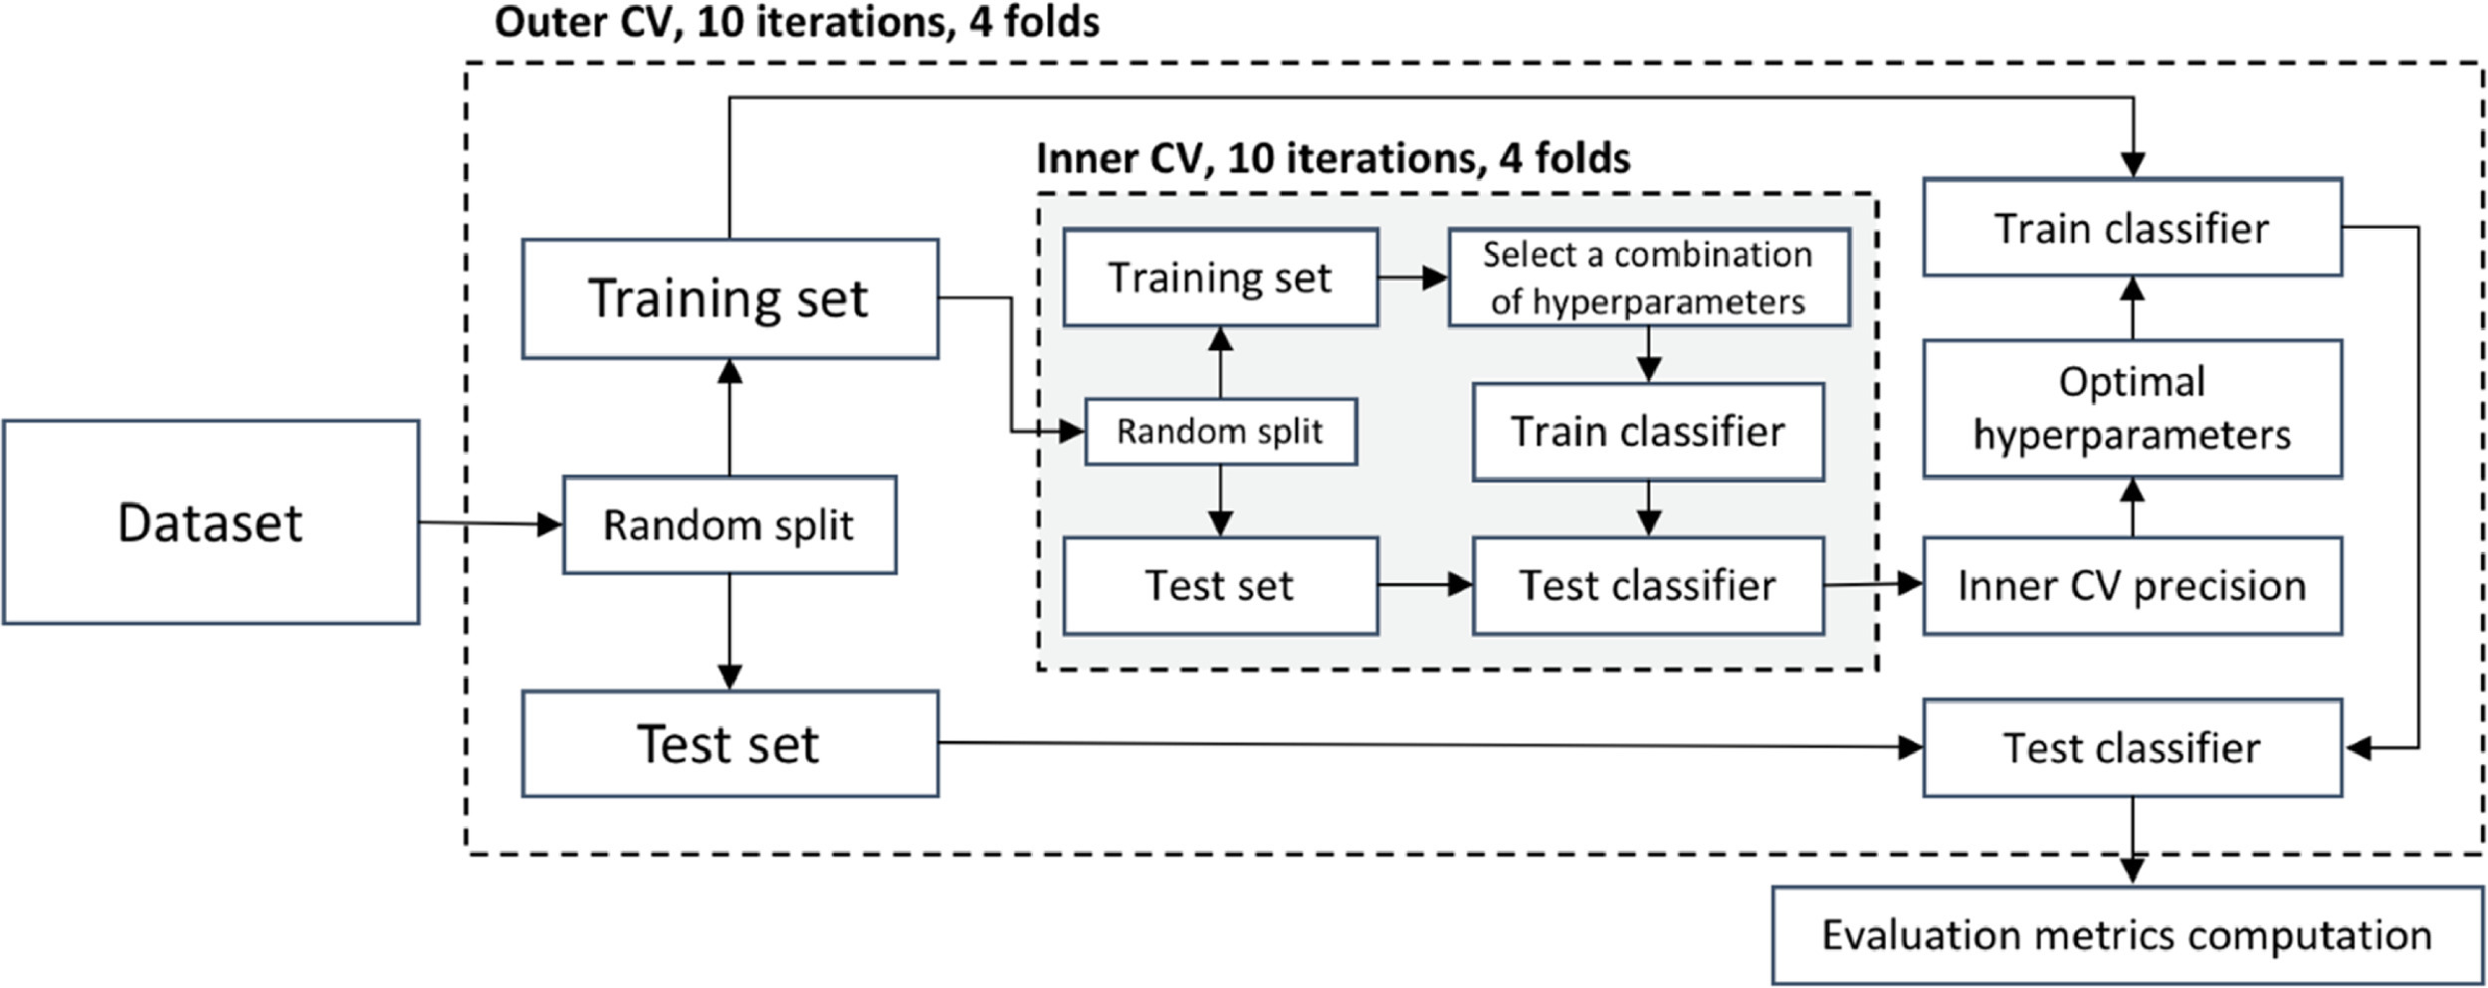
Nested Cross Validation

Slide 14
Results

Slide 15
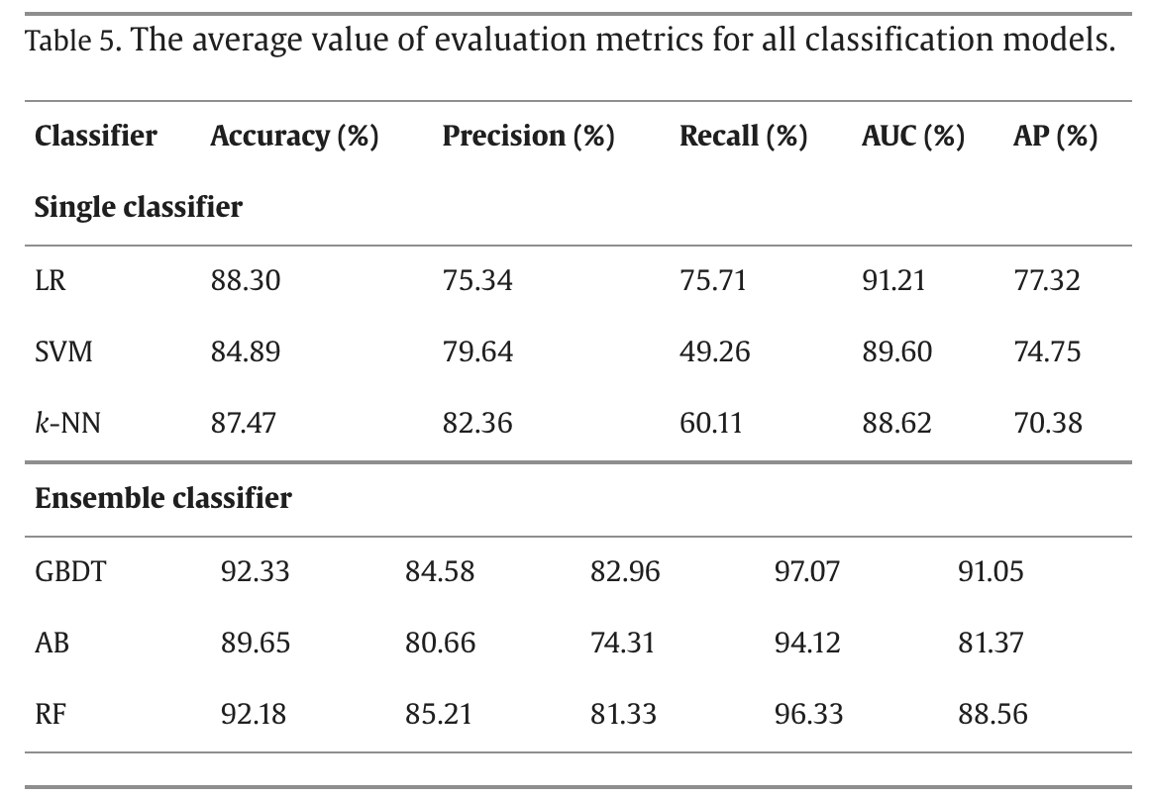
Results

Slide 16
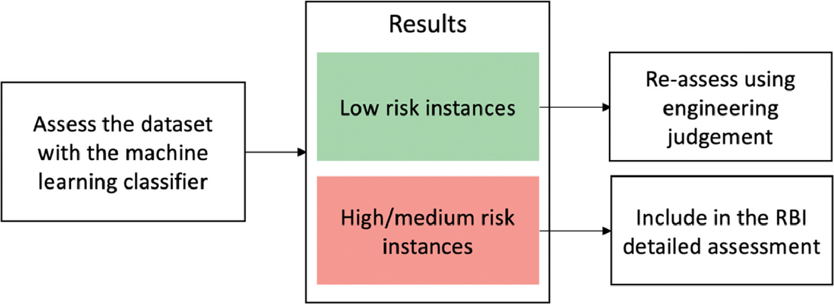
Final Recommendations

Slide 17
Thank You!

Slide 18
Reference
Andika Rachman, R.M. Chandima Ratnayake, Machine learning approach for risk-based inspection screening assessment, Reliability Engineering & System Safety, Volume 185, 2019, Pages 518-532, ISSN 0951-8320, https://doi.org/10.1016/j.ress.2019.02.008.

